Slide 1
5.01 Understand Different Types of Programming Errors
Computer Programming

Slide 2
Essential Standard and Objectives
Essential Standard 5.00 Apply programming and conditional logic
Indicator 5.01 Understand different types of programming errors. (3%)

Slide 3
Syntax Errors
Occur when the programmer does not follow the rules of the programming language.
Prevent the program from running
Also called Compilation Errors or Compiler Errors
There is a wavy line under them to alert the programmer.
The line is blue in Visual Basic

Slide 4

Logic Errors
Occur when the program compiles and executes, but the output is not what you wanted/expected.
Example in Visual Basic

Slide 5
Logic Errors
Why do you have logic errors?
Incorrect formulas
All possible inputs not handled
Desk Check
Desk checking is when you create a table of possible inputs and determine what the output should be.
Check expected input
Check unexpected input
Check boundaries
Check null input
Input | Expected Output | Actual Output
1 | 2 | 2
2 | 4 | 5
Nothing | Message | Error

Slide 6
Runtime Errors
Runtime Errors
Errors that occur while your program runs.
Why do you have runtime errors?
When your program tries to do an operation that is impossible to carry out.
The operation violates the rules of the computer.
Possible Causes
Divide by 0
Forgetting to initialize a variable

Slide 7
Runtime Errors
What happens?
Your program stops running.
A dialog box displays in the Code Editor window.
A description of the error is given.
Troubleshooting tips are given.
The program goes into “Break” mode where you can debug it.

Slide 8
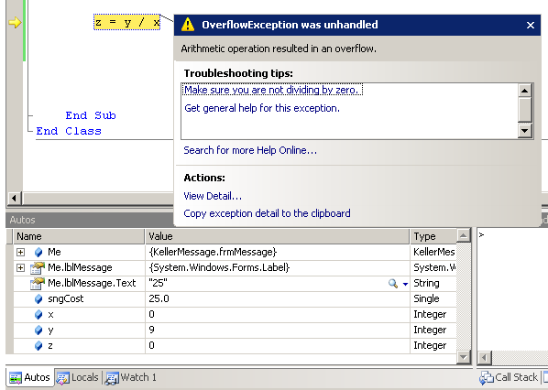
Runtime Errors

Slide 9
Wrapping it Up
In this lesson you learned about different types of errors.
For more information http://msdn.microsoft.com/en-us/library/s9ek7a19(v=vs.80).aspx

